Slide 1
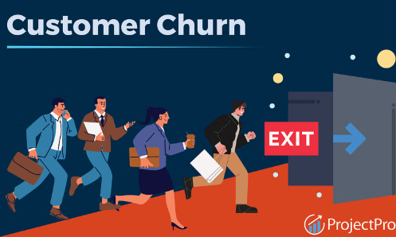
“Customer Churn Analysis & Prediction for Telco”
Presented By : Chhama Tomar

Slide 2
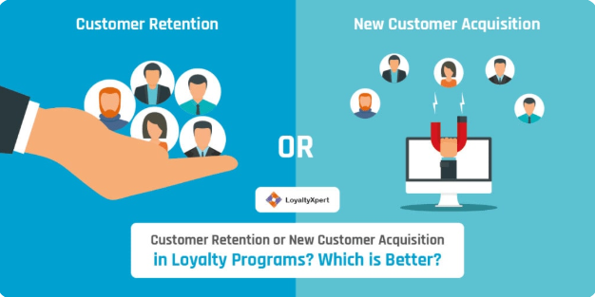
Problem statement:
“Customer churn is a major problem for telecom companies as retaining a customer is cheaper than acquiring a new one.”

Slide 3
Objective:-
Identify key factors behind churn
Build ML model to predict churn probability
Suggest business strategies to reduce churn

Slide 4
Dataset Overview:-
Target variable: Churn (Yes/No)
Major features:
Customer demographics (gender, senior citizen, partner, dependents)
Services (internet, phone, contract, payment method)
Charges (monthly, total charges)
Tenure

Slide 5
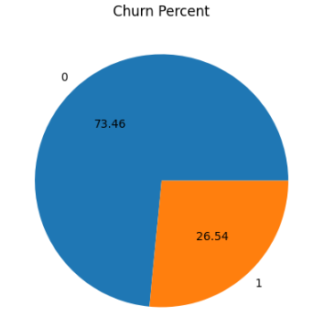
Exploratory Data Analysis (EDA) Insights:-
Churn Rate: Around 26% customers churned

Slide 6
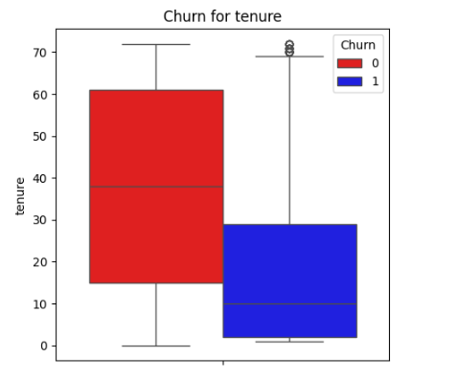
Tenure vs Churn: Short tenure customers are more likely to churn

Slide 7
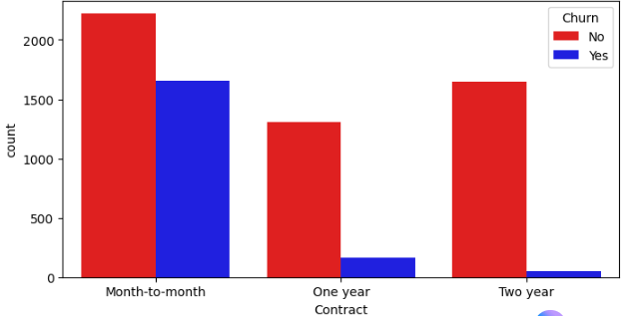
Contract Type: Month-to-month contracts have highest churn

Slide 8
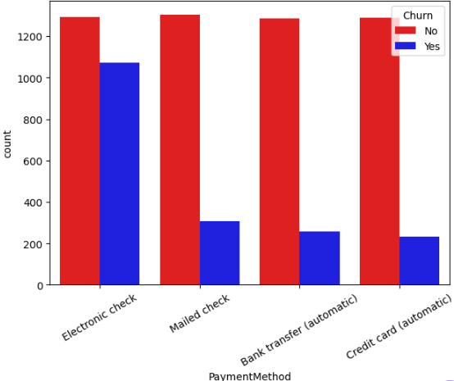
Payment Method: Customers paying via electronic check churn more

Slide 9
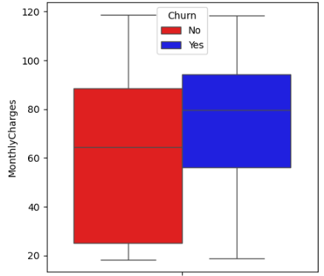
Monthly Charges: Higher charges = higher churn probability

Slide 10
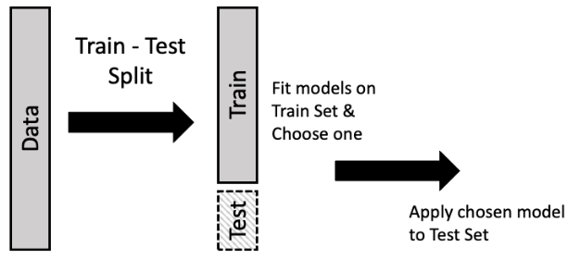
Data Preprocessing:-
Handling missing values
Encoding categorical variables (One-Hot, Label Encoding)
Train-test split

Slide 11
Model Building:-
Algorithms Tried : SVM(support vector machine) , Random Forest , Decision Tree
Evaluation Metrics: Accuracy,Recall,F1-score,precision,confusion matrix
Evaluation for SVM:-
Accuracy:76.29% F1-score:62.38%
Recall :74.26% Precision:53.78%
Evaluation for Random Forest:-
Accuracy:77.43% F1-score:60.74%
Recall :65.95% Precision:56.29%
Evaluation for Decision Tree:-
Accuracy:73.24% F1-score:54.41%
Recall :60.32% Precision:49.55%

Slide 12
SVM(support vector machine) is doing good because it has the highest recall value.
In Churn prediction ,Recall is highly prioritized ,because missing a churn customer leads to revenue loss, whereas false positives are comparatively less costly.”
Recall > F1-score > Precision > Accuracy

Slide 13
Key Business Insights:-
Customers with month-to-month contracts churn more → Encourage long-term contracts
Customers with high monthly charges churn more → Provide discounts or bundled plans
Customers using electronic check → Promote auto-payment / credit card payment
Low tenure customers churn more → Improve onboarding experience

Slide 14
Recommendations:-
Loyalty programs for long-term customers
Personalized offers for high-churn segments
Improve support for senior citizens
Encourage auto-pay & paperless billing

